Slide 1
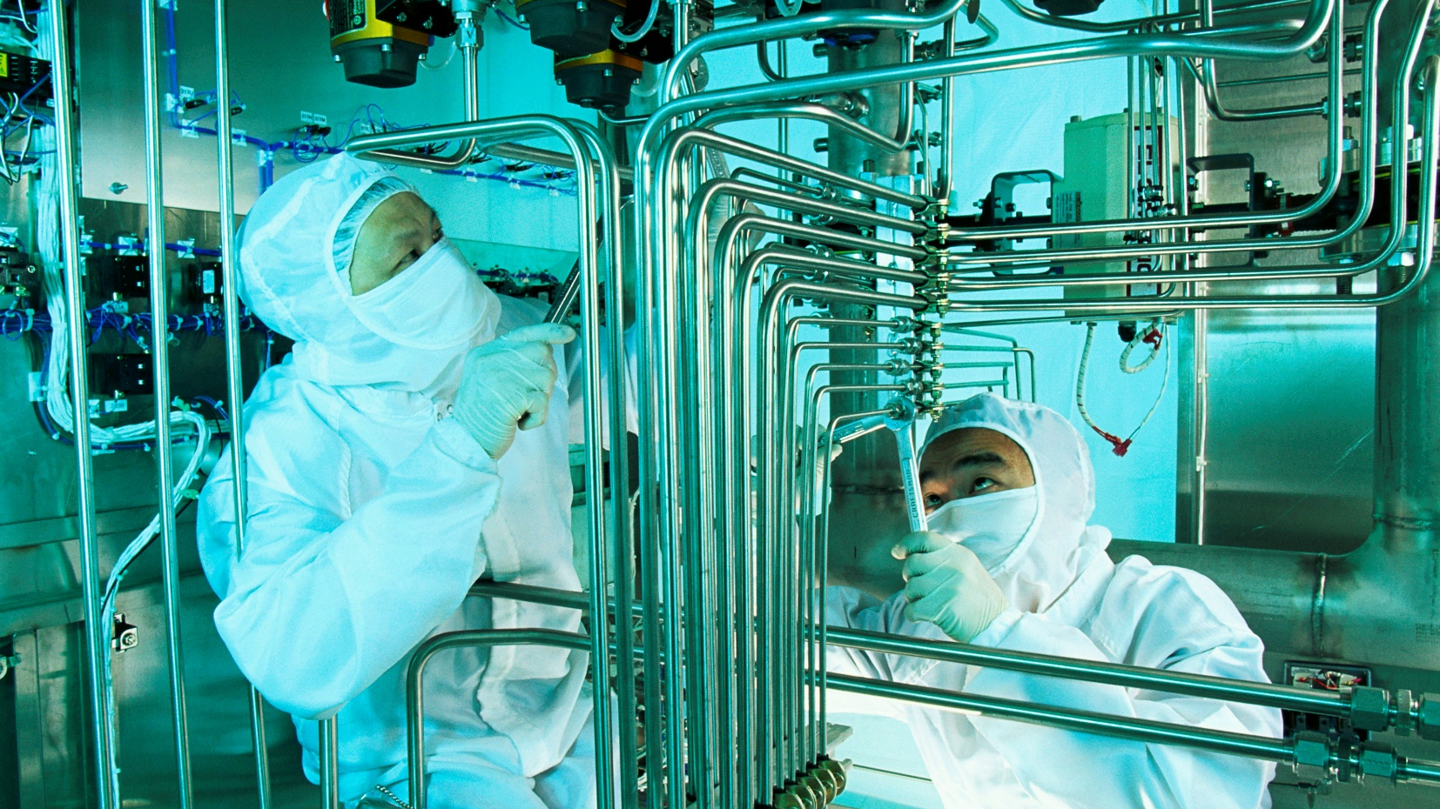
Managing and influencing subfab safety
Alan Ifould
Head of Marketing, Operational Excellence
SESHA SYMPOSIUM, July 2020
Notes:
Good morning everyone. Thank you XXXX for the introduction and warm welcome
I’m today deputising for Richard Meredith, who leads our SubFab safety programme, and who is on annual leave this week with his family
He has briefed me well on the material, and I will be happy to take any questions, but please accept my early apologies if I cannot answer every one
I will be happy to take any unanswered questions to Richard for follow up. My email address follows at the end of the presentation
[ANIMATE]

Slide 2

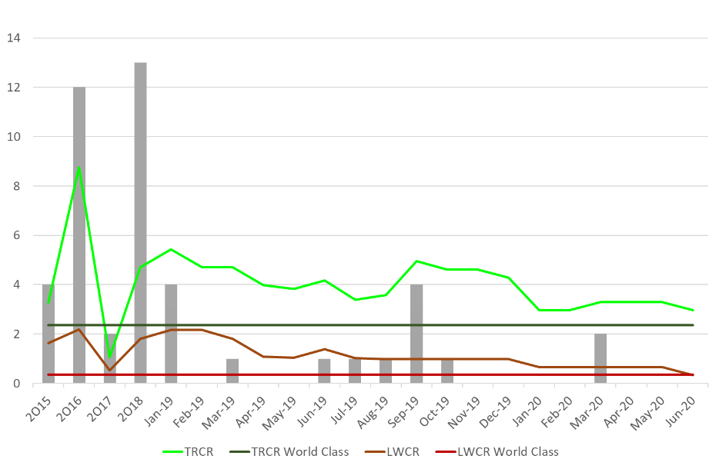
June 2020 Field Operations LWCR at World Class Benchmark
BREAKING NEWS
Notes:
It gives me great pleasure to start my presentation today with some breaking news, the timing of which is perfect for this webinar
In 2016, we set ourselves on a journey to achieve a world class safety performance benchmarked against the metrics and cultures of recognised leaders in the industry
[ANIMATE]
Our journey has been a long one, but we are pleased to report that in June this year we achieved world class lost work-day case rate (LWCR) across our Field Service Operations
But the journey is not over: we still have work to do to drive continuous improvement
Through this presentation, I will show you with some simple case studies how Edwards has used information technology, operational excellence, organisational and behavioural safety models to influence, manage, deliver and maintain a safe subfab working environment
[ANIMATE]
============= Background ==================
2016 TRCR = 8.7 cases per million hours worked, LWCR = 2.2 cases per million hours worked (rock bottom)
2017 Edwards benefitted from short term improvements and rode their luck as organisation and objectives were not in place ref. swiss cheese model (see backup)
No long term improvement programme in place as evidenced by the rise in 2018
2018 quantity of recordables higher but the worked hours increased as the semi market grows and service grows in turn to keep pace
2019 blip – no specific assignable cause, 4 incidents from different parts of the world >> put down to field service process variability
TRCR = total recordable case rate (i.e. all high consequence, lost work, restricted work & medical treatment cases) per million hours worked (data range last 12 months)
LWCR = lost work case rate per million hours worked (data range last 12 months)
TRCR & LWCR includes all accidents and ill health cases as per OSHA definitions

Slide 3

Challenges in the SubFab environment
The SubFab can be a dangerous place
A large space where people interact with machines and processes
Many suppliers often competing for the same workspace (e.g. overhead)
Challenging environments: toxic chemicals, restricted spaces, heavy equipment
Longevity of equipment lifecycle: design changes are slow to propagate
Time pressures: tool downtime
Notes:
Let’s start with a little context. The subfab is a different environment compared to the cleanroom
It lacks the high level of automated material handing present in modern cleanrooms, and relies heavily on the effective interaction of people, machines and processes
The subfab is large, and heavy equipment has to be moved long distances from storage to point of use
It is a 3 dimensional space, with equipment at all levels from floor to the waffle slab above. Overhead working presents risks both to those working at height, and those working in close proximity.
Space is often restricted, providing challenging ergonomic conditions in which to work. And of course subfab vacuum equipment funnels all the hazardous process by-products away from the tool.
We learn and improve ergonomics and safety features in our product development, but the lifecycle of subfab equipment is as long as 10 or 15 years, and so design changes can be slow to propagate
Finally, we all understand time pressures: if vacuum equipment is down, so is the process tool it supports
[ANIMATE]

Slide 4

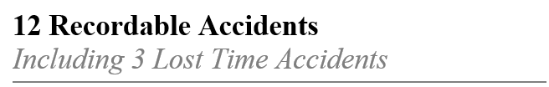

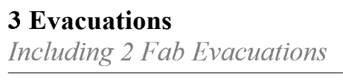
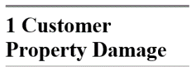
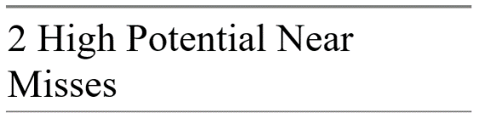
Where have we come from?
Key challenges
– what lies beneath the iceberg?
2016 History Lesson
Health & Safety Organisation
Disproportionate field service representation
Visibility of Data
Inadequate near miss reporting
Behaviours
100% recordable cases cite human behaviour
Growth and Ramps
Diluting our talent pool
Notes:
Back in 2016, those challenges contributed to a number of safety incidents, and an unacceptable set of safety metrics
Our teams suffered accidents including cuts and broken bones, and ill health including musculoskeletal disorders such as back injuries and strains
Safety excursions caused personnel evacuations and the consequent risks to people and equipment
[ANIMATE]
We took a look at the underlying challenges, and identified some core root causes
The field service organisation was disproportionately represented in our Health & Safety function, despite being higher risk workers. On average each region had around 20% of a safety manager, or in other words received management focus 1 week in every 5.
Visibility of our data was poor. Best practice safety cultures typically display Near Miss Reporting metrics at around 10 times other recordable injuries. In 2016 we had very little data. [Best practice reference is the Conoco Phillips Marine 2003 best practice accident ratio model]
Personnel behaviour was a contributing factor, with 100% of recordable cases in 2016 involving human behaviour as a contributing cause. This was a clear indication that at individual and team level fundamental appreciation and ownership of a safety culture was non-existent
A key contributor to all of these challenges was the shear pace of growth and associated ramps. We were recruiting fast in many regions, bringing on board personnel with little experience of the semiconductor industry. This diluted both the experience of our workforce talent pool and the safety culture. The rapid growth also exacerbated the disproportionate representation of the field service team within the health and safety organisation.
So what did we do?
[ANIMATE]

Slide 5
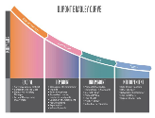

Our journey to world class
History Lesson 2008 to 2019
2008
2016
2017
2018
2019
Edwards launch a behavioural safety program called ActSafe & LeadSafe. Focus is internal. Accident rates fall.
Edwards outgrows its organizational resource model for field service. World class goals set.
Dedicated field service organisation forms with the objective to achieve world class performance
Focus on behaviours and culture through Operational Excellence
Mobile Reporting App launchs
Notes:
What we did was to start a journey, or rather change direction of a journey Edwards began in 2008.
Edwards started its safety initiative with a programme we called LeadSafe, ActSafe where both leaders and employees were encouraged to promote the right culture, for example by demonstrating Visual Leadership in observing safe behaviours, and making safety observations, good or bad. We established leading and lagging indicators based on OSHA standards. We drove safety improvement through proactive reporting, analysis and management action
However, the focus was on our factories where the biggest proportion of our workforce was located, and which were environments we could control and influence
Field service operations were small, they were in environment owned by our customers, and did not cause visible safety issues: we lost sight of our field service teams
But by 2016, our field service operations had outgrown the safety organisational model, risks were growing and it became clear we had to shift our focus
We set world class goals, and we began the journey I am about to share with you
[ANIMATE]

Slide 6
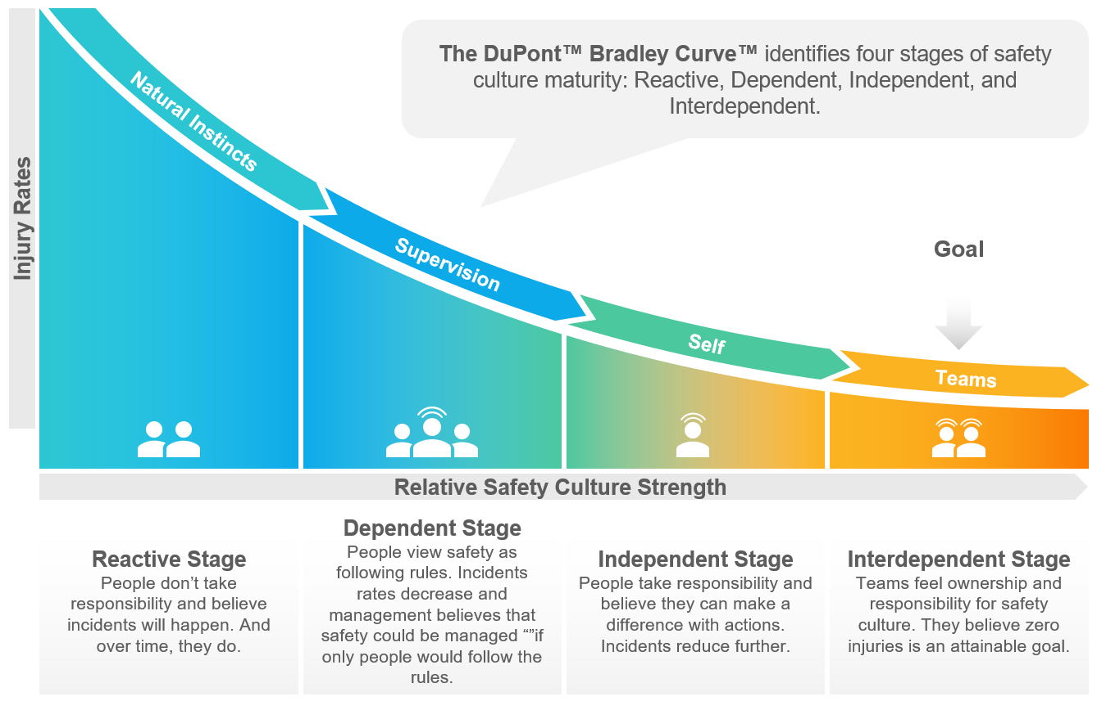
Our chosen destination: world class
An interdependent safety culture seeking zero injuries
Benchmarks set against the safety performance and cultures of leading semiconductor fabs using widely recognised OSHA metrics
Notes:
So how did we choose to a world class performance?
We chose to set benchmark ourselves against leading semiconductor fabs recognised as having world class safety metrics and cultures, and who used recognised OSHA defined metrics
But we looked beyond metrics, and understood how these leaders had themselves achieved world class performance
We learned world class is a mindset, an attitude and how individuals and teams behave: so we set our goals to achieve a true interdependent safety culture, where teams feel clear ownership and responsibility for safety, and where they believe zero injuries is an attainable goal
We also learned that world class also means not being afraid to share bad as well as good experiences outside of the company so others can learn, which I hope to do with you today
Let us now look at some of the challenges we faced, and how we overcame them
[ANIMATE]

Slide 7
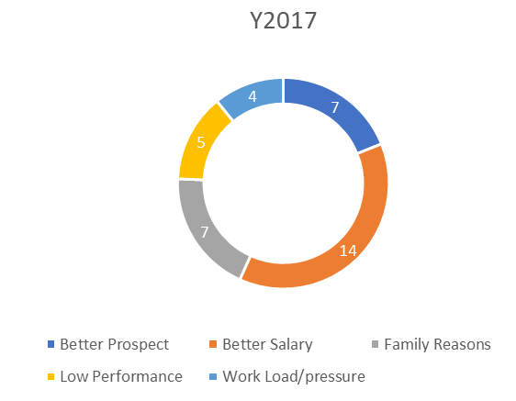

Case study: rapid expansion
China 2016 Semiconductor industry growth boom
Insufficient Field Service Engineers with industry experience
Field Service Engineers recruited from other industries
Staff turnover rate in 2017 increases to 25% >> organisational risks
Experienced talent pool is diluted
CHALLENGE
Notes:
My first case study addresses the challenges we had with a rapidly expanding organisation
Our field operations teams grew significantly from 2016, as the Semiconductor industry growth boom created demand for the service of vacuum equipment
I am going to focus on China, where the challenges were particularly apparent because of the relative infancy of the industry
We were unable to hire enough field service engineers with industry experience in China to keep pace with demand, and so we had to recruit from other industries
As well as the high rate of new starters, we struggled to keep staff turnover rate below 25%
We saw several effects, all of which are recognised in different accident causation models [for example Reason’s Swiss Cheese model]. Those effects included
An increased risk of accidents because of inexperience: the first few months in particular are the most dangerous
High amounts of training were needed, and therefore the experienced members of the team spent disproportionate amounts of time training
Of course, because of the high turnover rates, we saw these effects repeated, creating a vicious circle
Ultimately, customer satisfaction was impacted as experienced team members spend time training, not supporting the customer
We needed to take action to address this: we recognised the risk to a safe and effective working environment inexperience and high turnover creates
[ANIMATE]

Slide 8
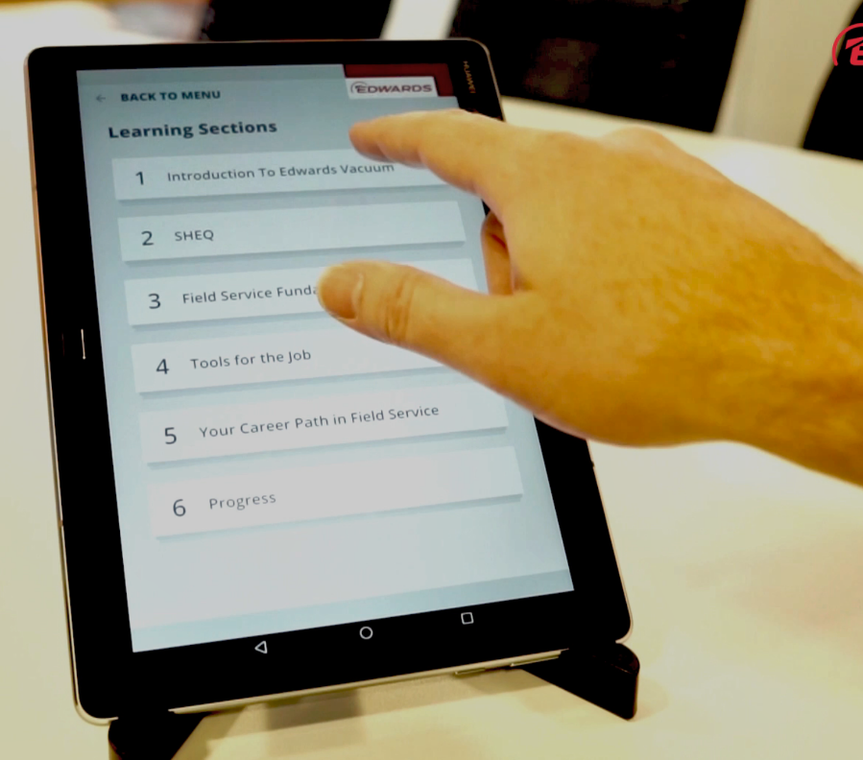
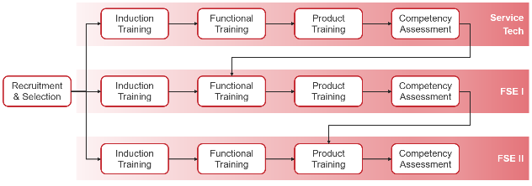
Case study: rapid expansion
Employee motivation programme delivering clear career prospects, formal progression, structured training and onboarding improvements to increase inclusion, employee value and belonging
2019 turnover rate falls to 10% and continues to fall in 2020 reducing the likelihood of accidents caused by inexperience
SOLUTION
OUTCOME
Notes:
Our solution was to address the underlying demotivators. It was not all about salary.
We tool steps to improve our onboarding and training processes, so that new FSE immediately felt equipped to tackle the job and were safety-conscious before the entered a fab
Information technology was used to deliver core training, increasing consistency of delivery and reducing the demands on our experienced team members
We found the use of technology particularly relevant as it was aligned to the learning expectations of our new staff who largely come from the millennial generation
The training process proved more engaging, and by comparison with using traditional methods we saw a better knowledge retention, improving time to safe competence
In parallel we created a simple but visible career progression pathway, supported by structured training to increase competency
These solutions had a positive effect on employee sense of belonging and value
We can’t honestly show an improvement in safety performance in China.
We put that down to luck: our timing was good in that we recognised the growing safety risk early, and whilst we were implementing we were fortunate the holes in our Swiss Cheese model never lined up well enough to cause incidents
However, we know that our risks are lower, and our continued low accident rates are a consequence of a well managed culture and environment rather than luck, and against a continuing background of growth

Slide 9

Case study: driving safety focus
North America
# FSE | 233
# Sites | 9
:FSE | 117
Unbalanced focus of organisation: factory rather than field
CHALLENGE
EMEA
# FSE | 118
# Sites | 11
:FSE | 118
A fully resourced team focussed on field operations.
To be extended with champion network
Asia
SOLUTION
# FSE | 1 165
# Sites | 119
:FSE | 137
Created the foundation of a world class safety culture that has this year delivered world class performance
Global
# FSE | 1 516
# Sites | 139
:FSE | 132
OUTCOME
Notes:
This case studies focusses on another consequence of the rapid growth: the fact that our field service operations were not well represented within Edwards safety management organisation
On average, each of our operational regions had leadership equivalent to 20% of one person. In other words, the focus of a safety professional just 1 day each week
Our total recordable case rate (TRCR) and lost workday case rate (LWCR) were unacceptable, and in fact the worst they had ever been
So we took action, and recruited. We now have a truly global organisation who have been successful in implementing safety cultures in our regional teams, and have contributed enormously to our attainment of our world class benchmark
We still have more to do. The ratios of our safety professionals to workforce are better than our benchmark, of approximately 1:200
But we find our teams are still stretched by geography. We have large number of FSE, working work across many different sites
Our average team on site is around 11 people, unlike a single fab where several thousand people work in one place
We need to continue our journey towards a true interdependent culture where teams feel ownership and believe their actions can make a difference. More about that later.

Slide 10
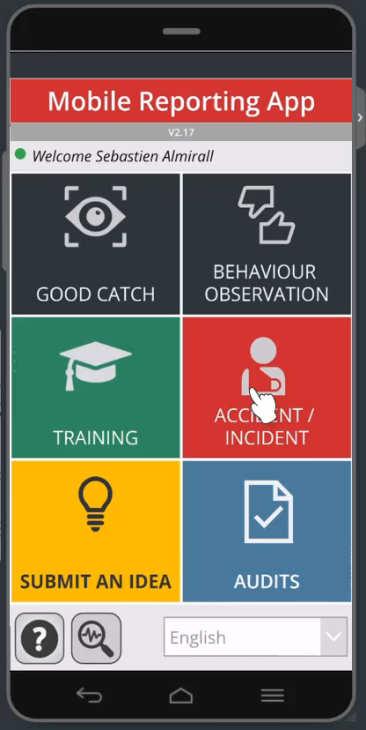
Case study: using technology to improve safety culture
Visibility of data
Our behavioural safety business process did not work: Field Service staff had to wait to connect via VPN to report. Process engagement was low.
Our solution was to put safety reporting literally “in the hands” of our employees. A simple, easy to use mobile reporting app enabling “as it happens, where it happens” safety observation reporting
Global rollout repeats the results of an overwhelmingly positive trial. Improved reporting drives visibility, response and continuous safety improvement. Acceleration of the culture shift and our progress towards interdependence: individual ownership and influence on health and safety
CHALLENGE
SOLUTION
OUTCOME
Notes:
So what came next?
A successful safety culture means that individuals and teams feel ownership for that culture, and believe they can make a difference
A key enabler of this behavioural safety is the ability for teams to make safety observations, good or bad, and for the management team to be able to act on that information
Our behavioural safety business process did not work. It was originally designed around factory operations, running on servers behind our firewalls and intended to be accessed from a PC
This made it hard for our field service teams to report. They had to wait to connect via VPN to report, and the portal was not user friendly. Process engagement was low, and we lacked good data to drive safety improvements
In August 2018 we made it our goal to put safety reporting literally “in the hands” of our employees, using mobile app technology that was freely available to Edwards
[ANIMATE]
A very successful pilot was run 3 months later, and in January 2019 after an overwhelmingly positive trial, global Field Service roll out began, with results mirroring the trial
The improved reporting drives visibility of, and rapid response to safety issues and trends, accelerating our continuous safety improvement
There was one benefit we had not anticipated. The roll out of the app underlined the message to our workforce that health & safety is important, and that they have ownership
It has helped reinforce the influence and ownership individuals and teams have on health and safety, helping us evermore towards a truly interdependent safety culture

Slide 11




Safety benefits from a holistic approach
People
The SubFab is a complex environment where people machinery, data, technology and processes interact closely
Data & technology
Machines
Process
Notes:
An enduring lesson we learned on our journey is that safety in the subfab deserves a holistic approach
The subfab is a challenging and complex environment, where people interact closely with one another, with machines, and with processes
Demands and challenges are numerous: we needed to create the environment where everyone and everything and reaches their full potential, safely
Having a health and safety organisation and improving culture is a huge step forward, but we recognised that safety is fundamental to fab success, and so looked at how we can bake safety into our subfab operations model
Let’s explore that

Slide 12
Operational excellence enables world class safety performance
Voice of Customer and Fab Success
Actionable Insight drives Continuous Improvement
Collecting and sharing domain expertise enables effective asset management
Safe products, processes and tools
Sharing of safe and effective solutions
End to end value chain feedback drives improvement into products and operations
Knowledge Management
Design for Service
Planning safe intervention. Technology enables safe processes and culture
Safety embedded in culture and behaviour
Data analytics prolongs use of assets and resources, and eliminates disruptive surprises
VTPS, our LEAN Operations Model, drives safe, effective process and behaviour
Digitalisation
Customer Experience
VTPS LEAN Operations Model
Collaborative customer safety engagement
Safety skills and awareness
Strong support and governance for effective customer collaboration
Maximising the potential of our human resources
Customer Support
Consistency
Training & Development
Extending useful asset life between service
Quality & Reliability
Health & Safety
Ensuring equipment operates safely
Cultivation of a safe working environment
Creating a safe environment for our people and our customers
Notes:
Operational excellence is our core field operations model: I won’t go through the whole model in detail, but in summary, it drives our field service organisation to deliver continuous improvement to external and internal customers, leveraging a number of technologies, principles and capabilities
[ANIMATE]
Health and Safety is of course a key part of the model, and I’ve already shown a number of the improvement activities that have been driven by the team to cultivate a safe working environment
But we use Operational Excellence to drive our safety culture into every aspect of what we do
[ANIMATE]
The knowledge we gather is shared to drive both safe practices, improve the safety of product and process designs, and ensure equipment operates safely
[ANIMATE]
Data analytics allow us to predict maintenance events, enabling better planning and preparation, eliminating the temptation to rush potentially dangerous tasks. Digital technologies make our behavioural reporting effective
[ANIMATE]
Training improves safety skills and awareness, whilst the use of LEAN operations models encourages standard, consistent and safe working practices
[ANIMATE]
Finally, and with as much importance as the others, we support our customers, internally and externally, to aspire to and achieve a similar safety performance
This is our holistic approach, and how we embed safety into everything we do, think and behave, and what has helped us to achieve our world class benchmark

Slide 13
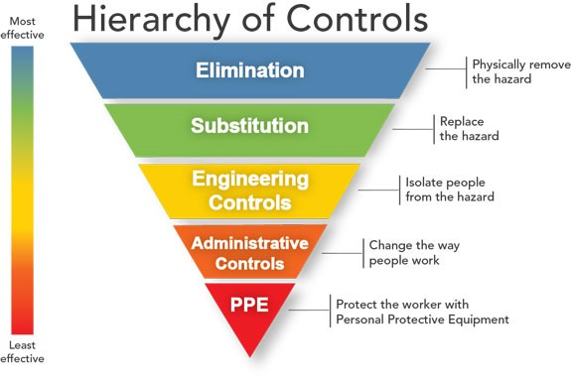
Case Study: Semi S30, Energetic Materials & Operational Excellence
Energetic materials can injure personnel, damage equipment, and cause significant loss of production if not handled properly
Semi Standard Semi S30 recommends best practice
Operational Excellence practice enables robust implementation
Best practice risk management where hazards are eliminated or substituted
CHALLENGE
SOLUTION
OUTCOME
(Source: National Institute for Occupational Safety and Health
Notes:
Let’s examine Operational Excellence in practice now
Process chemicals and by-products used in Semiconductor manufacturing are often energetic materials that can injure personnel, damage equipment, and cause significant loss of production if not handled properly.
My colleague, Steve Cottle, recently discussed at this forum the recently published Semi S30 standard on safe handling of energetic materials
Successful implementation of the standard requires careful and detailed consideration of all aspects of their use and disposition.
Most incidents occur in the sub-fab, where materials can accumulate in vacuum lines and pumps. These accumulations may not be apparent until unwittingly exposed during maintenance.
The risk of negative consequences increases when a maintenance or repair procedure is rushed in response to an unexpected equipment failure.
Best practice is achieved when well-designed equipment, matched specifically to process requirements, is supported by an integrated program of operational excellence that brings together domain knowledge, risk analysis, performance monitoring, data-driven decision making, predictive maintenance, and cautious, well-trained personnel working in a pervasive culture of safety
In this way, the organisation is best placed to eliminate or substitute hazards through careful design and planning of support activities. Reliance on least effective controls such as PPE & administrative controls such as procedures & signs is greatly reduced. These controls should always be a last resort as they rely on strict adherence and the absence of human error to be effective.
This is the essence of our operational excellence model: we strive to eliminate or substitute hazards by considering safety in everything we do, and using our learning to improve equipment and best known methods

Slide 14

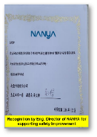
True world class performance can only be recognised externally
The proof of the pudding…
We are proud to be recognised by our customers for the success our safety programme is delivering
At a number of customer operations, the Edwards approach and culture is held as an example to be followed
Other Recognitions
KR | 1
CN | 4
SEA | 2
US | 1
Notes:
We can see from our metrics that we have achieved world class performance, but to claim true world class performance it is said that only be recognised externally
We are proud to receive customer awards and recognition for our safety achievements. I can’t share all of them with you, but can give a sample
[ANIMATE]
Many of the awards commend the safe behaviour of our FSE’s including challenging customers (and holding firm) where we feel what we have been asked to do is unsafe
To us that is a true measure of world class: our people challenge unsafe behaviour with confidence and reason, and our customers use them as examples of best practice
Perhaps our proudest moment is being recently asked to champion subfab-wide safety programmes at a major Asian customer
We are excited to be able to share our learning and experience with other vendors who share our workspace

Slide 15


Our journey continues
Our plans to build on solid foundations
Managing & promoting positive mental health & wellbeing
Surveys, action plans, accredited training
Empowering Safety Champions
Coordinating, coaching & leading subfab companies
Accredited Health & Safety Training
Operational Excellence
Focus on design for safety to improve service ergonomics
Technology to mitigate hazards
Notes:
World class behaviour does not have an end, but is a continuing journey
We still have room for improvement, and here are some of our plans
The world is becoming ever more aware of the importance of mental health and wellbeing, and we are actively providing accredited Mental Health & Wellbeing Training for our teams
We spoke early about our organisation: it needs to grow, but rather than recruit more specialists, we plan to empower safety champions within our teams. We have been asked to champion safety within some of our customer operations
Our operational excellence model continues to drive improvements. Service ergonomics is a high priority: how do we make maintenance of our equipment easier, more comfortable and thus safer? How do we use technology to further eliminate or mitigate hazards?

Slide 16
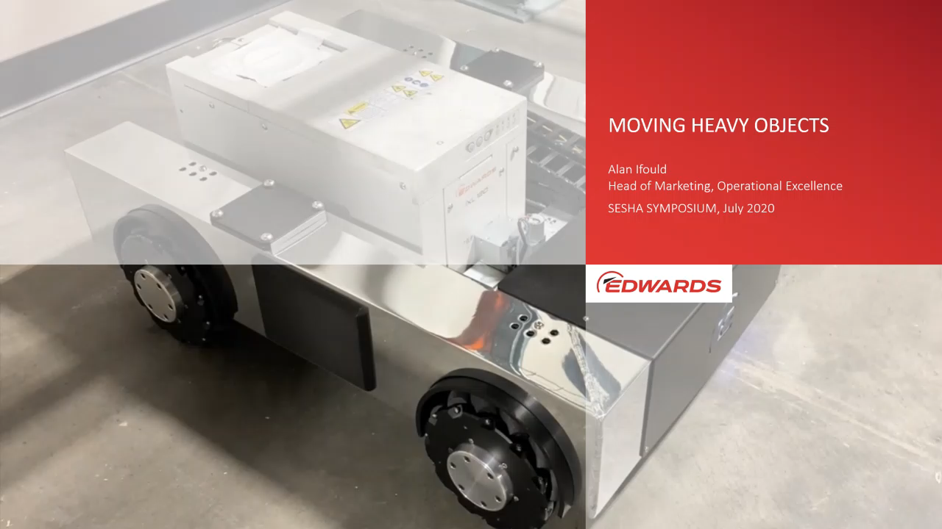
Case study: exploring technology to improve safety culture
Moving equipment around the subfab is a hazardous task and results in recordable incidents.
Tooling and procedures delivered improvements, but incidents still happen.
How can we reduce risk further?
Use technology to reduce the need for human effort to move heavy equipment
Autonomous prototypes are working and soon to be field trialled.
CHALLENGE
SOLUTION
OUTCOME
Notes:
On that note, before I wrap up let me share one last case study illustrating how we see technology improving safety
Project Percheron is a research and development project that is using outcome-driven solutions to drive value for our customers in the sub-fab and beyond
[ANIMATE]
An early initiative is the use of automated guided vehicle technology to remove risks of manual handling
In my opening slides I described how people in the subfab interact with machines and processes, and the challenges of moving heavy equipment around a large space
The reality of this is that employees have suffered injuries as severe as broken bones
We mitigated that risk a few years ago with revised tooling and handling procedures, but still incidents happen
Vacuum equipment is not getting smaller, and space restrictions constrain both the physical size and location of equipment, and working conditions
In 2018, four employees suffered serious hand injuries whilst transporting vacuum pumps around customer factories: in each case the employee’s hand was crushed between the pump and another immovable or heavy object
Vehicle prototypes are now operational, and we expect to be taking these to field trials in the near future

Slide 17

In conclusion
World class performance means striving to improve no matter how good you are, is hard to achieve and even harder to maintain
Safety is an organisational priority outside of the full control of Health & Safety teams, and therefore behaviour is a keystone of subfab safety
It is difficult, but not impossible, to influence 139 onsite teams over 3 continents if the organisation is right-sized and individuals feel empowered
The importance of safety is critical to the onboarding process, setting correct behaviours early and maintaining staff retention
Technology is core to continuous improvement, enabling elimination of hazards, adapting to changing workforce expectations, and empowering individuals
A holistic operational excellence approach encourages safe behaviour in everything the organisation does and drives continuous improvement
Notes:
So in summary, here are the key conclusions we have reached so far on our journey
World class performance means striving to improve no matter how good you are, is hard to achieve and even harder to maintain
Our journey has been one of continuous improvement, addressing issues one by one to build the safety culture
But we know we can’t reduce effort or focus. Despite our lost workday case rate achievement, we still have accidents
We have unfortunately recorded a lost time incident in July, emphasising the need to continue the journey with the same enthusiasm and rigour
Safety is an organisational priority outside of the full control of Health & Safety teams, and behaviour is the keystone of subfab safety
The initial part of our journey relied on the health and safety teams defining and encouraging adherence to rules
But the subfab environment is not owned by Edwards, and is shared with many other teams
Individual and team ownership and responsibility for safety, the true interdependent culture, is what is driving our progress
It is difficult, but not impossible to influence, 139 onsite teams over 3 continents if the organisation is right-sized and individuals feel empowered
We have a significant safety organisation in place now, with 12 safety professional supporting our team of around 1 500 personnel
That makes the job of communicating, training, reporting and acting on safety matters easier, but each one has on average 12 sites to support
The recurring theme here is empowerment of individuals and team to own and be responsible for safety
The importance of safety is critical to the onboarding process in terms of setting correct behaviours early and maintaining staff retention
We now introduce our safety culture very early in the onboarding process, usually in the first hours of employment
The effect has been twofold: the safety culture is emphasised, and Edwards is seen as being a responsible, caring employer that has contributed to our improving retention rates
Technology is core to continuous improvement, enabling elimination of hazards, adapting to changing workforce expectations, and empowering individuals
We could not have made the progress we have without embracing technology
Information technology resonates well with our new employees, who are typically young
It has made engaging with our safety culture simple and effective for all employees, helping to nurture the team and individual ownership and responsibility of safety
Technology has potential to reduce human interaction with hazardous tasks, even in the subfab
A holistic operational excellence approach encourages safe behaviour in everything the organisation does and drives continuous improvement
Embedding safety into the operational excellence is perhaps an obvious thing to do, but we have found that holistic approach especially effective
Operational excellence is about eliminating risk and uncertainty. It becomes a natural extension for our teams to think about safety risk in parallel with other risks, such as equipment faults
The techniques and data analytics we use to learn about and improve equipment performance apply equally as well to improving safety
The culture of pride, ownership and responsibility we engender applies as well to workplace effectiveness as it does to workplace safety
The focus on customer, internal or external, fosters engagement and communication, and a collaborative approach to reducing risk
Operational excellence helps our mission to eliminate or substitute hazards by considering safety in everything we do, and using our learning to improve equipment and the way we work and think safely

Slide 18
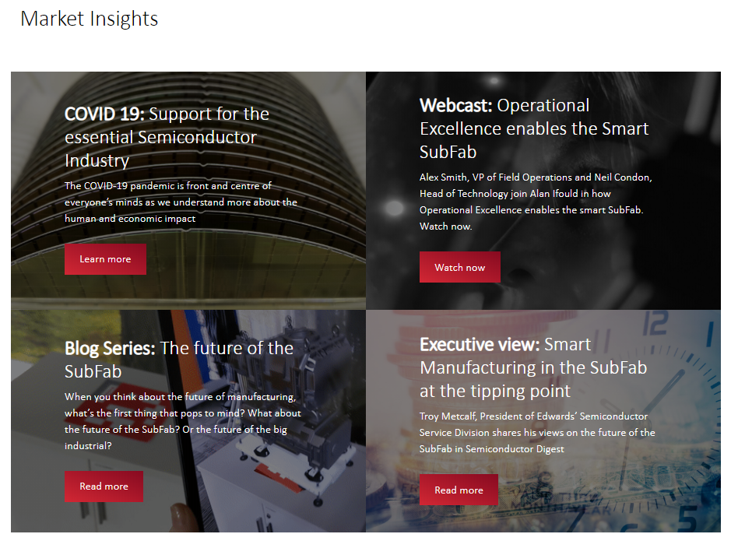
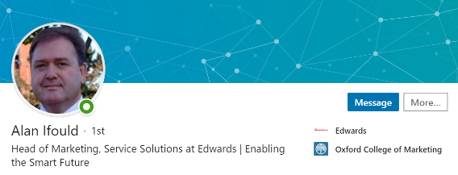

Further information and resources
edwardsinnovation.com/operational-excellence/
Email questions:
alan.ifould@edwardsvacuum.com
LinkedIn:
https://www.linkedin.com/in/alanifould/
Notes:
Thank you for taking the time to hear about our journey towards world class safety performance
I hope it has been informative, and will contribute to your own journeys
We share our operational excellence insights on our website, www.edwardsinnovation.com
Our blog series will feature our safety journey in an upcoming edition, due in early August
I’m happy to take any questions now, or you can contact me by email at alan.Ifould@edwardsvacuum.com, or get in touch via LinkedIn

